Slide 1
CLOUD OPTIMIZERS
VINAY KHEDEKAR
TEJAS GHALSASI
MOMTAZ AFREDI

Slide 2



A short Background on HDFS and MAP Reduce.

Slide 3
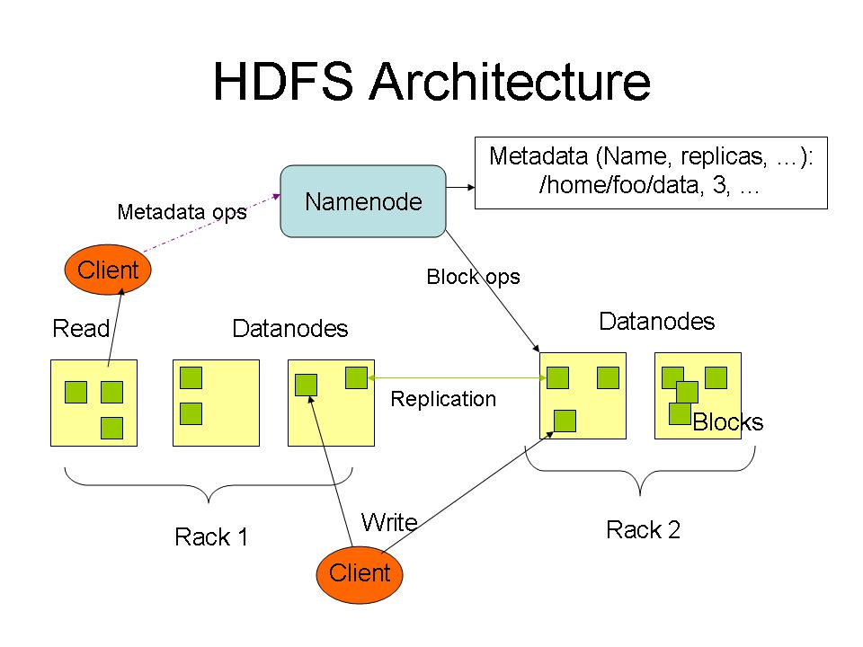

Slide 4
MapReduce: The Map Step
Input
key-value pairs
Intermediate
key-value pairs
k
v
map
k1
v1
k
v
k2
v2
map
k
v
…
…
kn
vn
k
v
E.g. (doc—id, doc-content)
E.g. (word, wordcount-in-a-doc)

Slide 5
MapReduce: The Reduce Step
Intermediate
key-value pairs
Output
key-value pairs
Key-value groups
k
v
k
v
v
v
reduce
k
v
reduce
k
v
k
v
group
k
v
v
k
v
…
…
…
k
v
k
v
k
v
E.g. (word, wordcount-in-a-doc)
(word, list-of-wordcount)
(word, final-count)
~ SQL Group by
~ SQL aggregation

Slide 6
Basic Features of Hadoop
Highly fault-tolerant
High throughput
Suitable for applications with large data sets
Streaming access to file system data
Can be built out of commodity hardware

Slide 7


Slide 8
Hadoop Configurations
The Hadoop framework has more than 190 tunable configuration parameters that allow users to manage the flow of a Hadoop job in different phases during the execution process.
Some important configurations are discussed in the next slide.

Slide 9
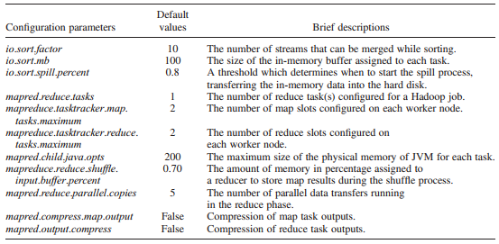
Hadoop Configurations
Notes:
2.1. io.Sort.Factor This parameter determines the number of files (streams) to be merged during the sorting process of map tasks. The default value is 10, but increasing its value improves the utilization of the physical memory and reduces the overhead in IO operations. 2.2. io.Sort.mb During a job execution, the output of a map task is not directly written into the hard disk but is written into an in-memory buffer, which is assigned to each map task. The size of the in-memory buffer is specified through the io.sort.mb parameter. The default value of this parameter is 100 MB. The recommended value for this parameter is between 30% and 40% of theJava_Opts value and should be larger than the output size of a map task, which minimizes the number of spill records [11]. 2.3. io.Sort.Spill.Percent The default value of this parameter is 0.8 (80%). When an in-memory buffer is filled up to 80%, the data of the in-memory buffer (io.sort.mb) should be spilled into the hard disk. It is recommended that the value of io.sort.spill.percent should not be less than 0.50. 2.4. Mapred.Reduce.Tasks This parameter can have a significant impact on the performance of a Hadoop job [21]. The default value is 1. The optimum value of this parameter is mainly dependent on the size of an input dataset and the number of reduce slots configured in a Hadoop cluster. Setting a small number of reduce tasks for a job decreases the overhead in setting up tasks on a small input dataset, while setting a large number of reduce tasks improves the hard disk IO utilization on a large input dataset. The recommended number of reduce tasks is 90% of the total number of reduce slots configured in a cluster [8]. 2.5. Mapreduce.Tasktracker.map.Tasks.Maximum, mapreduce.Tasktracker.Reduce.Tasks.Maximum These parameters define the number of the map and reduce tasks that can be executed simultaneously on each cluster node. Increasing the values of these parameters increases the utilization of CPUs and physical memory of the cluster node, which can improve the performance of a Hadoop job. The optimum values of these parameters are dependent on the number of CPUs, the number of cores in each CPU, multi-threading capability, and the computational complexity of a job. The recommended values for these parameters are the number of CPU cores minus 1 as long as the cluster node has sufficient physical memory [9–11]. One CPU is reserved for other services in Hadoop such as DataNode and TaskTracker.
2.6. Mapred.Child.Java.Opts This is a memory related parameter and the main candidate for JVM tuning. The default value is –Xmx200m, which gives at most 200 MB physical memory to each child task. Increasing the value of Java_Opt reduces spill operations to output map results into the hard disk, which can improve the performance of a job. By default, each work node utilizes 2.8GB physical memory [11]. The worker node assigns 400 MB to the map phase (i.e., two map slots), 400 MB to the reduce phase (i.e., two reduce slots) and 1000 MB to each DataNode and TaskTracker that run on the worker node. 2.7. Mapred.Compress.map.Output, mapred.Output.Compress These two parameters are related to the hard disk IO and network data transfer operations. Boolean values are used to determine whether or not the map output and the reduce output need to be compressed. Enabling the compression of the map and reduce outputs for a job can speed up the hard disk IO and minimize the overhead in data shuffling across the network.

Slide 10
VINAY

Slide 11
MOMTAZ

Slide 12

THANK YOU ALL!

